Slide 1


Dynamic Reporting with R Markdown
U.S. Fish and Wildlife Service
Jason Ross
Ashland Fish and Wildlife Conservation Office, Ashland WI.
Jacob Cochran
Lower Great Lakes Fish and Wildlife Conservation Office, Basom, NY
Jonah Withers
Conservation Genetics Laboratory, Anchorage, AK
Notes:
JW

Slide 2

Course Overview
Introduction to R Markdown
Nuts and bolts
You will have to knowledge to start your own
Disclaimer: Jake, Jonah, and I have done a fair amount of work with R Markdown, but we certainly do not have all of the answers. R Markdown is a big world and we have probably only scratched the surface on the capabilities!
Notes:
JW

Slide 3
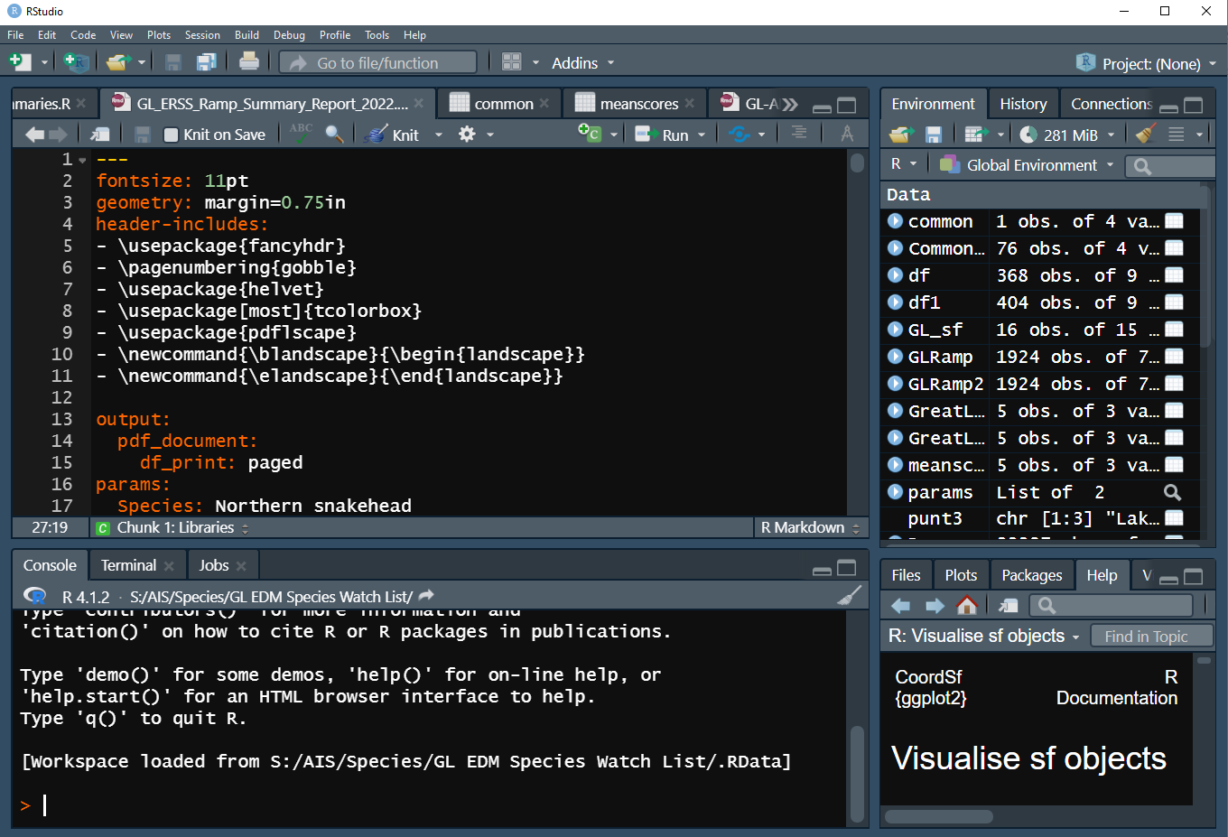
What is R Markdown
Base R:
A free open-source environment for computing statistics or graphics
R Studio:
An Integrated Development Environment for R
R Markdown:
A tool within R to create a document that is fully reproducible
Every aspect captured in code
Notes:
JW

Slide 4
What kind of documents can you render in R Markdown?
HTML: Language for webpages
Shiny applications: Interactive web-based application
MS Word: Language for Microsoft Word
PDF: Uses LaTex to generate PDF
Presentation: Presentation viewer/PDF
Notes:
JW

Slide 5
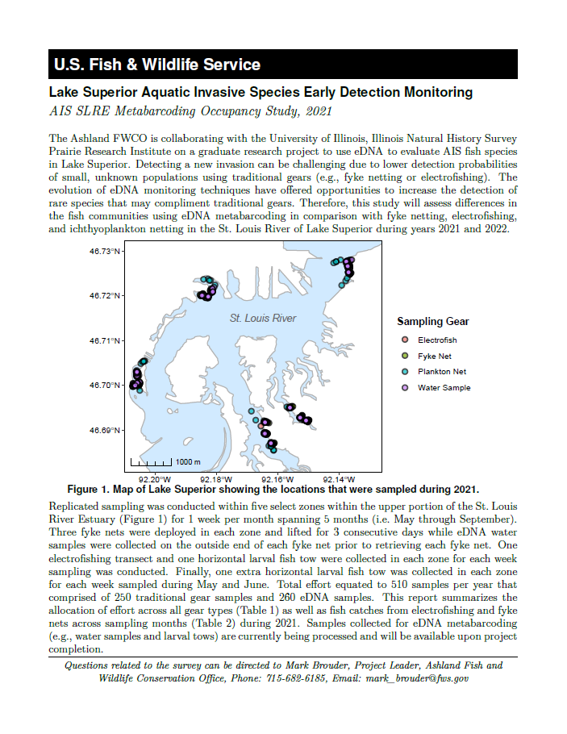
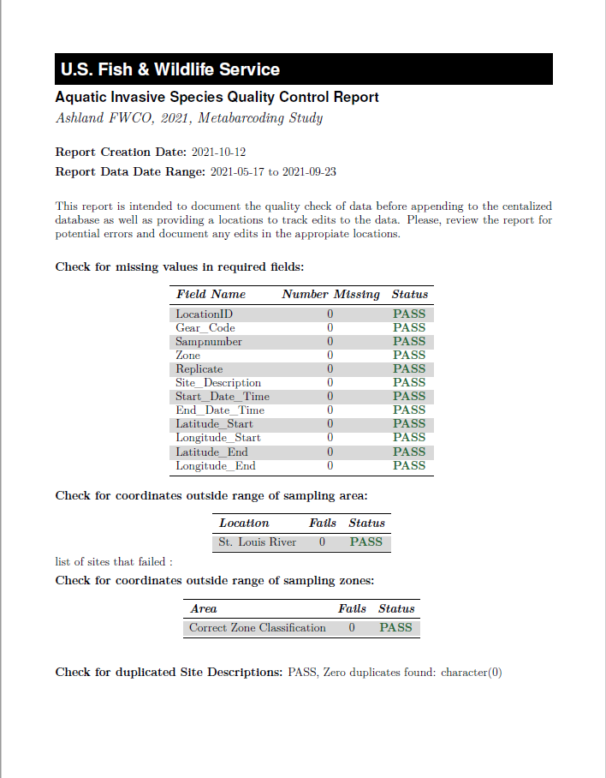
When to use an automated report?
If you have a document that you are generating:
Frequently
Weekly, monthly, annually
E.g., Quality Control Reports or Annual Reports
Duplicated reports for multiple factors
Species, watershed, state
Notes:
jw

Slide 6
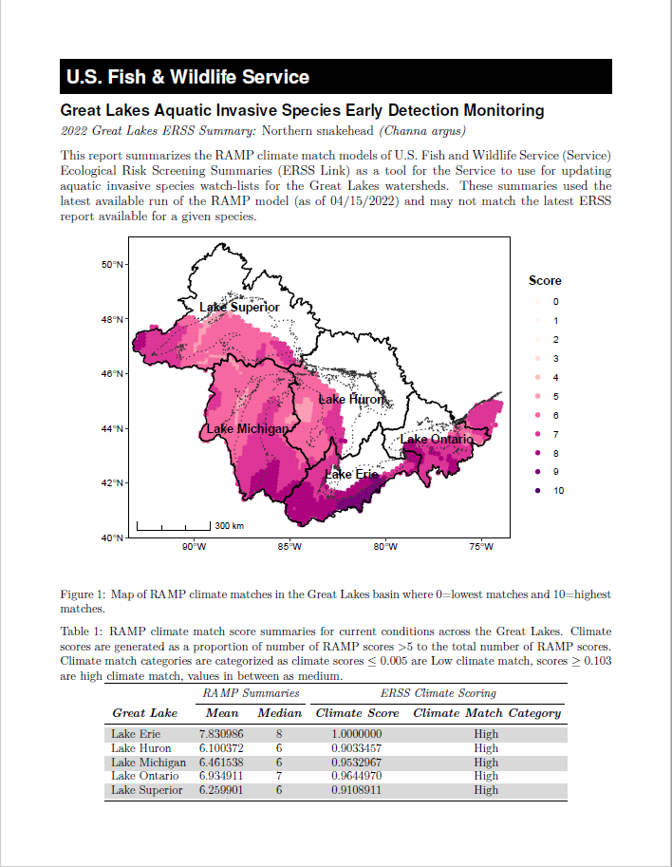
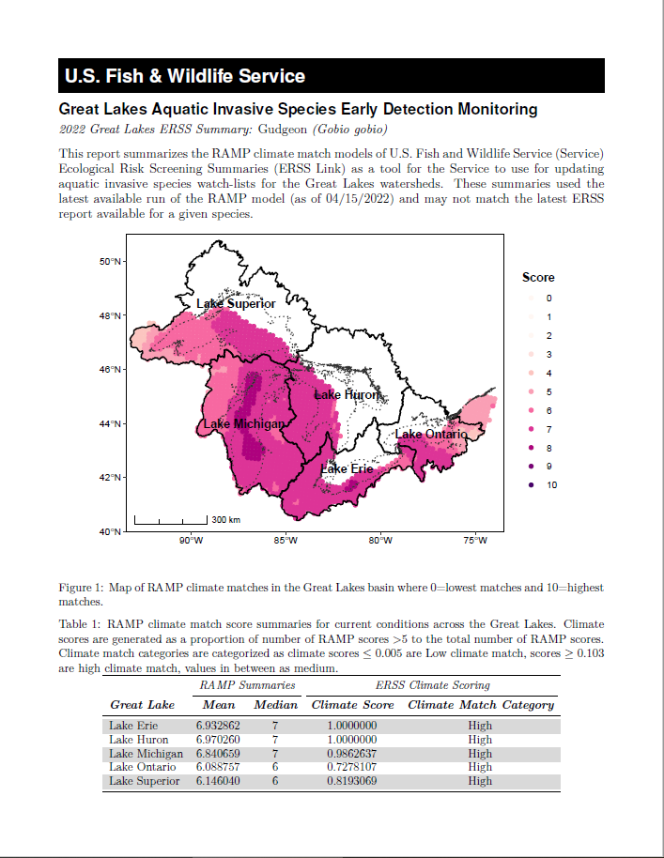
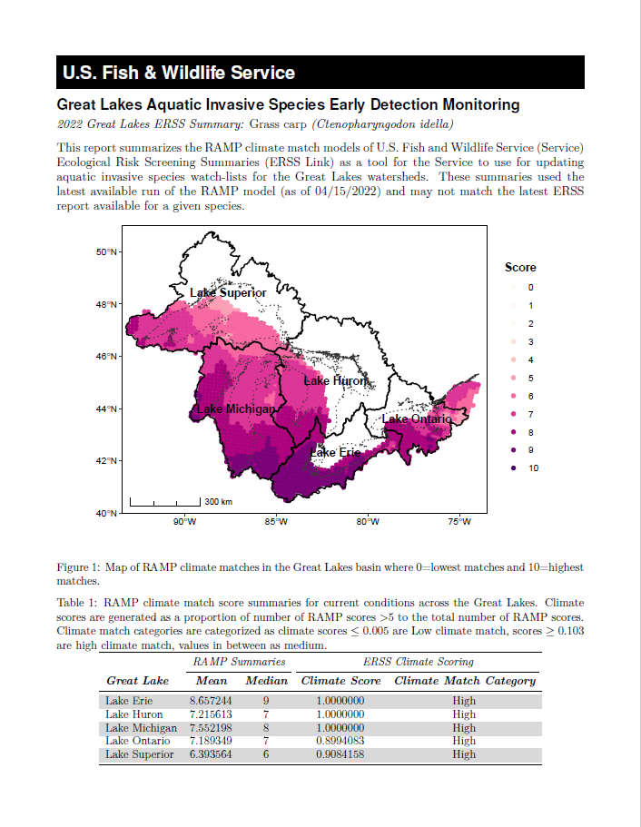
When to use an automated report?
If you have a document that you are generating:
Frequently
Weekly, monthly, annually
E.g., Quality Control Reports or Annual Reports
Duplicated reports for multiple factors
Species, watershed, state
Notes:
JW
Species Watchlist Report: Summarized Climate match data for ~90 species instead of rerunning the report individually for each species.

Slide 7
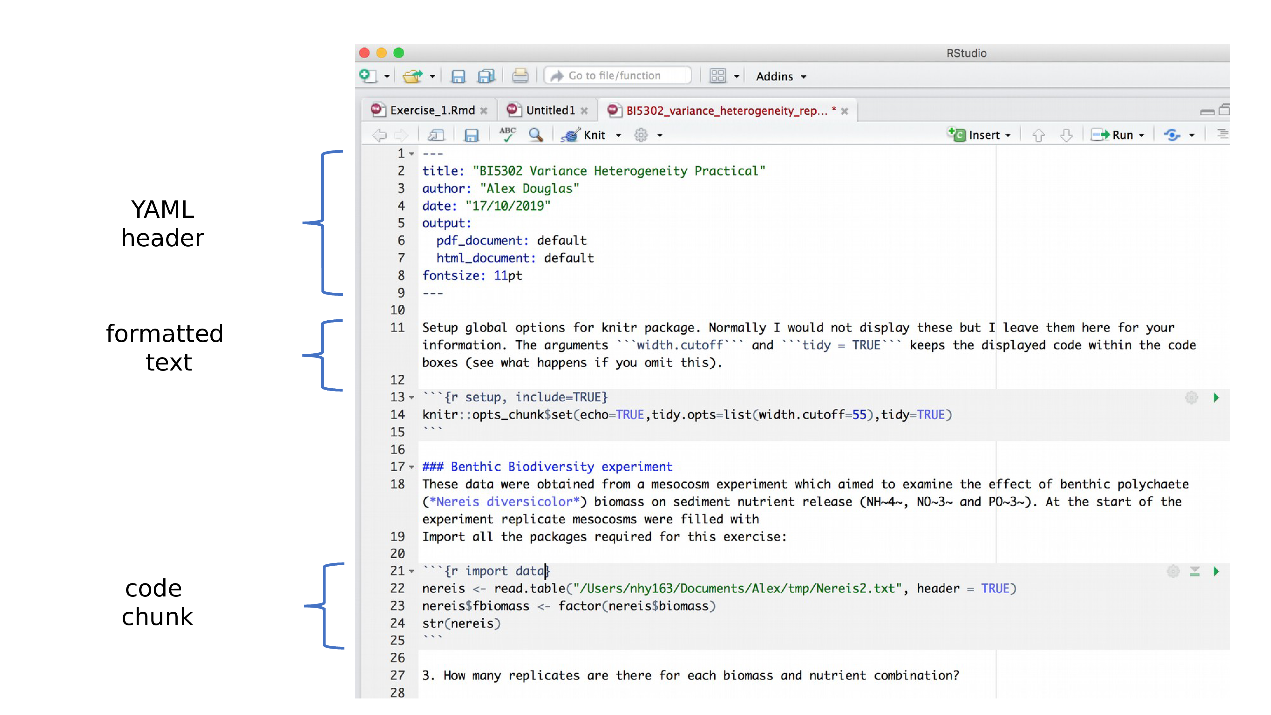
Anatomy of an R Markdown File
Notes:
JC
There are three parts of a Rmd. The YAML header, the main text, and code chunks.

Slide 8
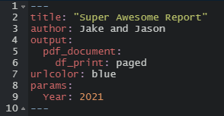
Anatomy of an R Markdown File: YAML Header
Metadata!
Processed during rendering
Read by Pandoc, rmarkdown and knitr
Parameters
Notes:
JC
Every Rmd document starts with a YAML which is a recursive acronym for “YAML ain’t markup language”. YAMLs always start and end with “---” and include the metadata of your document such as the title of the document, author, and an output which specifies which format the document will be written in. Behind the scenes, your R Markdown will be knit to a markdown file which is then read by Pandoc. Pandoc reads the YAML to know which file type to write the document to.

Slide 9
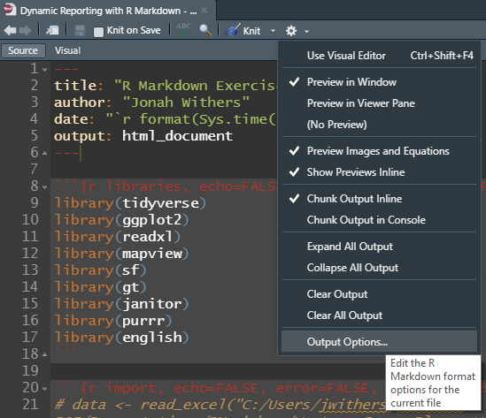
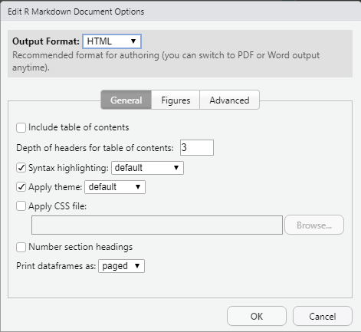
YAML Options
https://cran.r-project.org/web/packages/ymlthis/vignettes/yaml-fieldguide.html
https://pandoc.org/MANUAL.html#extension-yaml_metadata_block
Notes:
JW
There are a lot of options you can specify within the YAML section. They can be very simple or complicated and a little tricky to set them up at first. You can reference these sites below for help or, in Rstudio, you can select the gear icon at the top and select “output options…” which helps you set up the YAML
Helpful information on: YAML https://pandoc.org/MANUAL.html#extension-yaml_metadata_block
https://cran.r-project.org/web/packages/ymlthis/vignettes/yaml-fieldguide.html

Slide 10
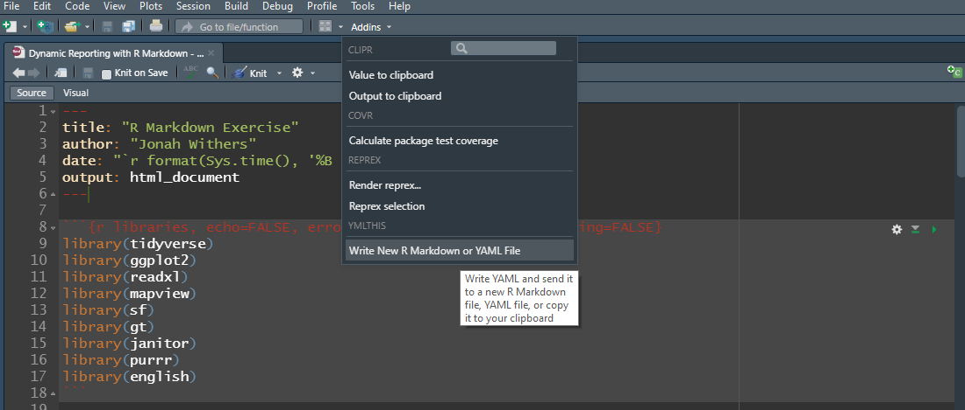
YAML Options
Package = “ymlthis”
Notes:
JW
If you still need help, you can try the “ymlthis” package which adds a plugin to your Rstudio. By selecting the “Write New R Markdwon or YAML File” option under the Addins menu….

Slide 11
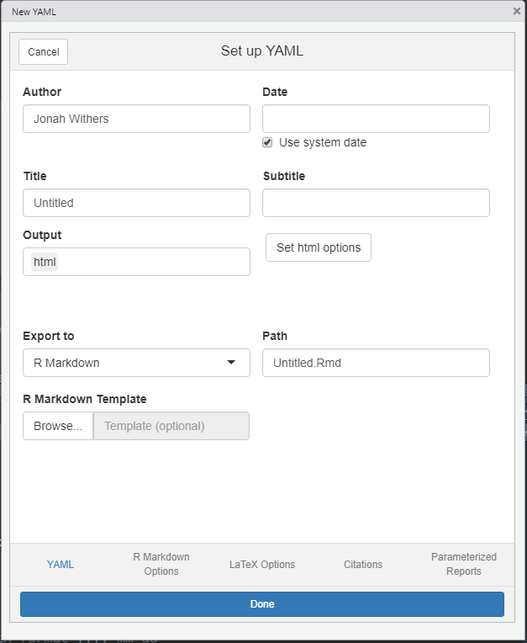
YAML Options
Package = “ymlthis”
Notes:
JW
A window pops up that helps you set up your YAML in a pretty user-friendly way.

Slide 12
Anatomy of an R Markdown File: Narrative
More straightforward – text editorish
Combine text and code!
Document structure as well
Raw content – LaTeX or HTML
Notes:
JC
This section is where you can write you document text. One of the advantages of using R Markdown, is that it allows you to incorporate code within your text. In the example above, you can see the ‘r denotes inline code section. Note that in inline code and code chunks, the user specifies “r” after the ``` or ` This is because you can include various languages like python, SQL, R, or Julia so the user needs to specify which language they’re using. After the `r, the inline code filters and extracts data from the AIS_Salary_Budget_Log so as the data in budget log is updated, the text will be updated the next time the R markdown file is run.

Slide 13
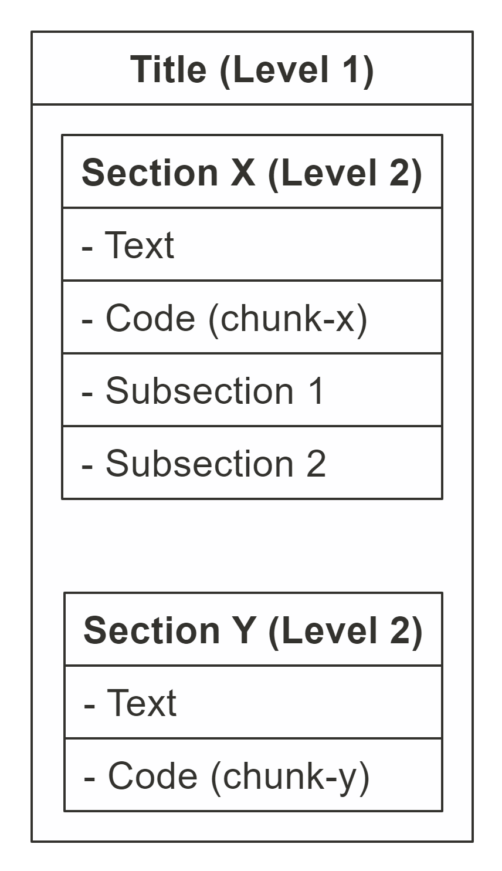
Anatomy of an R Markdown File: Document Body
Sections and containers
Particularly useful in formatting/styling
Notes:
JC

Slide 14
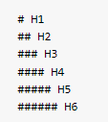

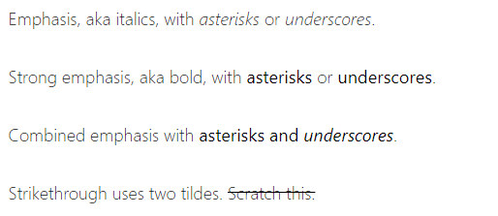
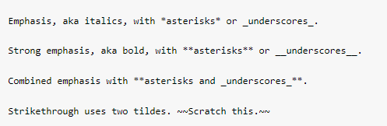
General Document Styling
Depends on the output.
Headers:
Emphasis:
Output
Output
Notes:
JC

Slide 15
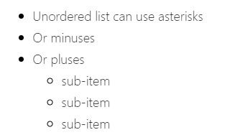
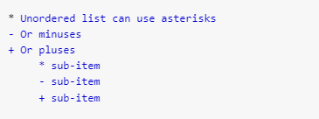
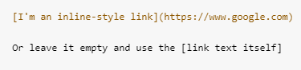

General Document Styling
Output
Lists:
Hyperlinks:
Output
Notes:
JC

Slide 16
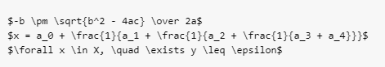
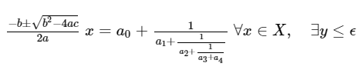
General Document Styling
Mathematical Formulas:
Output
Notes:
JC

Slide 17
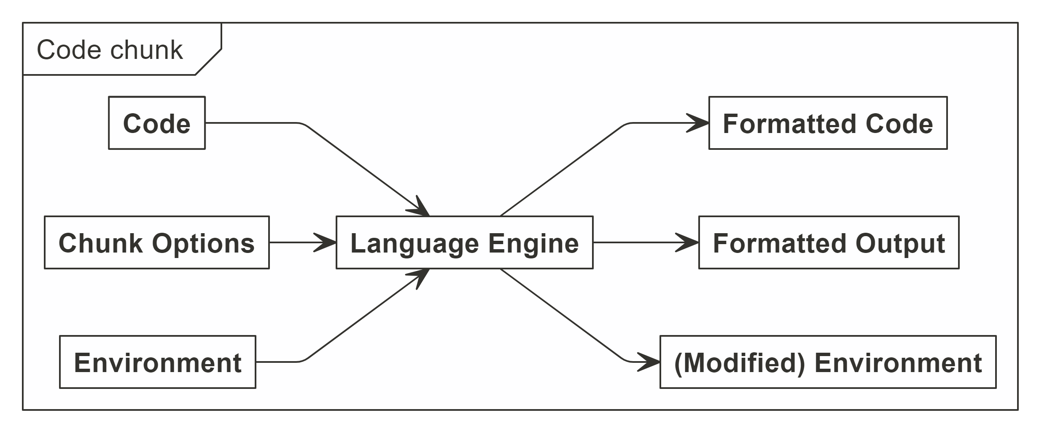
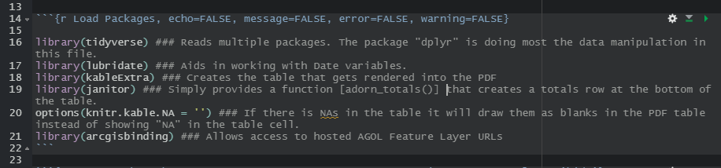
Anatomy of an R Markdown File: Code Chunks
What makes .RMDs so great!
Knitting environment, code input and chunk options
Notes:
JC
Code chunks are what make Rmd so great. They allow you to integrate code into your document so that it is dynamic. Code chunks always start will ```{r} and end with ```
A shortcut for inserting a code chunk is Cntrl + Alt + I
Alternatively, you can click the +C icon in the top right of the window.

Slide 18
Code chunks
```{r specifies that code will be in language r
After ```{r you can provide a title for the code chuck. It’s a best practices to include a title to help with navigation, troubleshooting, and organization.
After the title are the chunk options which are separated by commas
Echo: T/F to include code chucks in output. Code is run
Include: T/F to include chunks and results in output. Code is run
Eval: T/F to run the code. Code is shown in output
Error: T/F to include errors. Code is run
Message: T/F to include messages from code in the output
Warning: T/F to include warnings from code in the output
Notes:
JW
Note that in inline code and code chunks, the user specifies “r” after the ``` or ` This is because you can include various languages like python, SQL, R, or Julia so the user needs to specify which language they’re using
In code chunks, after the ```{r the user can provide a title for the code chunk. Its good practice to provide one to keep things organized, create a useable outline, and help troubleshoot the code if there’s an error.
After the title of the code chunk, the user can provide options which are separated by commas. There a ton of different options but here are some common ones used. https://rmarkdown.rstudio.com/lesson-3.html

Slide 19
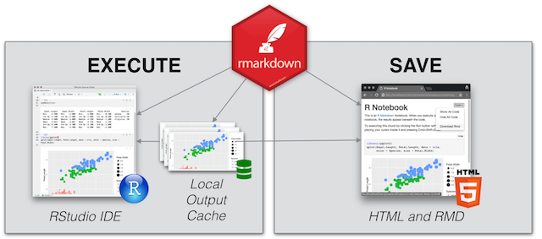
What about R Notebooks?
R Markdown = File
R Notebook = Way to work with R Markdown Files
Interactive execution of code chunks
Organize analysis and outputs
Render to Word, PDF, and HTML
Notes:
JC

Slide 20

Considerations
KISS
Less chances for package failures
Strive for full automation
Set up document for success
Reduce the errors by manually making updates
E.g., Year, number of samples, location names, etc.
Generalize where you can
Specificity may require updating paragraphs or code
Gold Standard for Automation
Update YAML and hit Run
Notes:
JC

Slide 21
Best practices
Folder structure
Directory, file, and R object naming
Create an R project
Bundles work into self-containing folder
Allows version control – Github
Reduces directory name changing
Keep code tidy and well-documented
Include comments
Include headers and subheaders
Short but descriptive (PBear_2020_harvest.csv)
No spaces or special characters (!@#$.)
Include a changelog (or README file) and keep it up to date!
Notes:
JW
Before we dive into R Markdown, we wanted to touch on a few best practices for project maintenance. When setting up a project you’ll want to think through your folder structure and naming schemas to help keep things organized in a logical manor. Remember to keep names descriptive but short and avoid using spaces or special characters (with the exception of underscores or hyphens). Be sure to include a changelog or README file so others can figure out the structure. And remember to keep it up to date!
When building R Markdown files, R scripts, notebooks, or apps its recommended you set up R projects. R projects allow you to bundle all the materials associated with the project into a self-containing folder. It also allows you to enable version control via Github or GitLab. Finally, R projects allow you to specify paths that are not user-specific.
Finally, we’d just like to remind everyone to include comments in their code where necessary and include headers and subheaders. During the demonstrations, we’ll show you how to set create and view these.

Slide 22

Facility Status Reporting
Covid-19 Incident Management Team
The White House's push to "Open" public lands!
Pressure on FWS leadership to track facility status
The previous excel based workflow was insufficient and time consuming – hours per day!
Notes:
JC

Slide 23
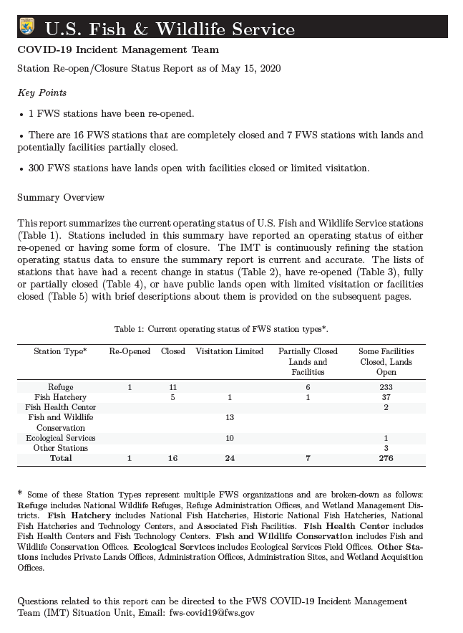
The R Markdown Solution
Streamlined data sources
Created an R Markdown Report
Provide daily updates to leadership
FWS Director appreciated format
Notes:
JC

Slide 24
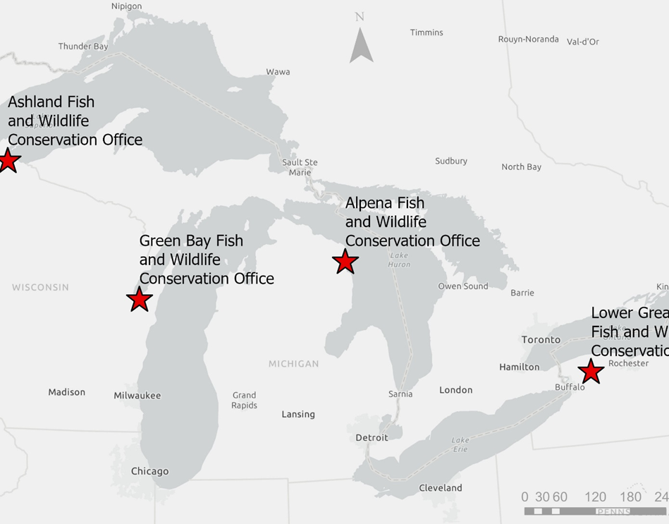
Great Lakes AIS Early Detection Monitoring
4 offices working independently to deliver EDM Program
Field work
Data management
Reporting
A need to consolidate data to generate a unified annual report
Notes:
JC

Slide 25
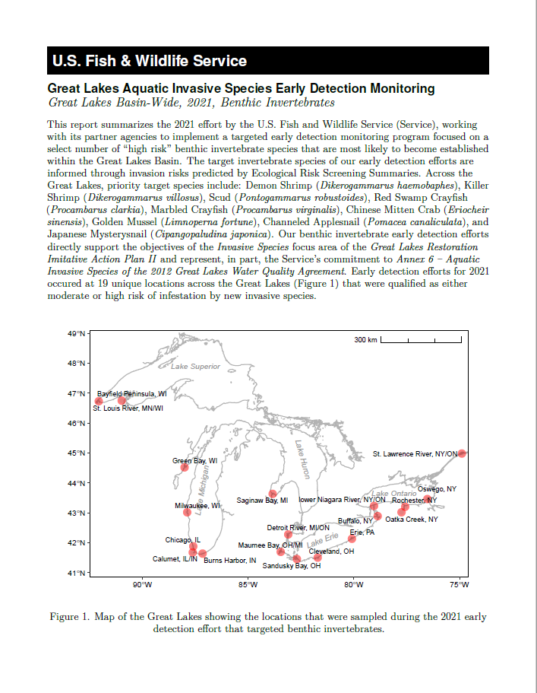
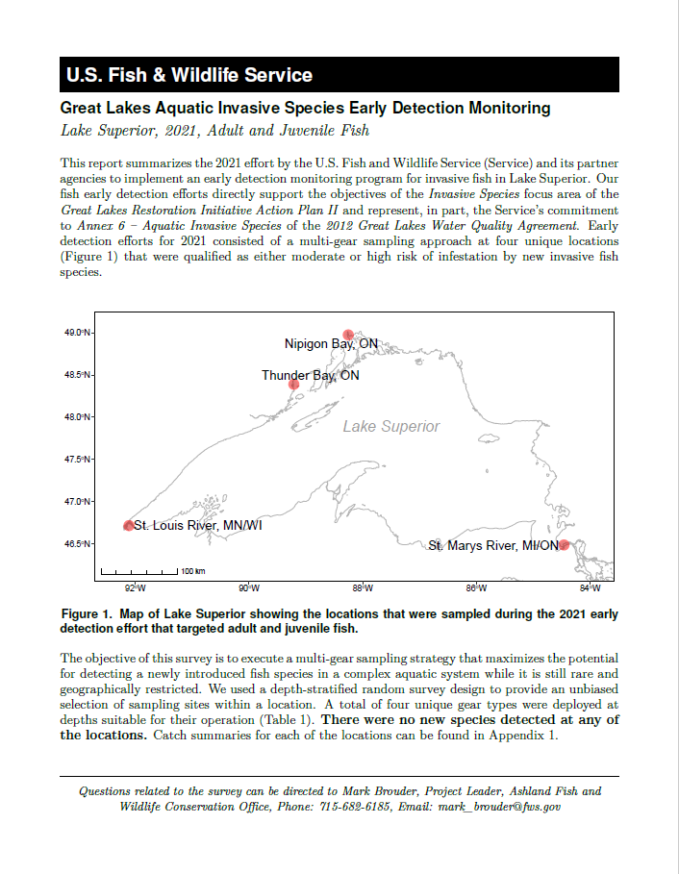
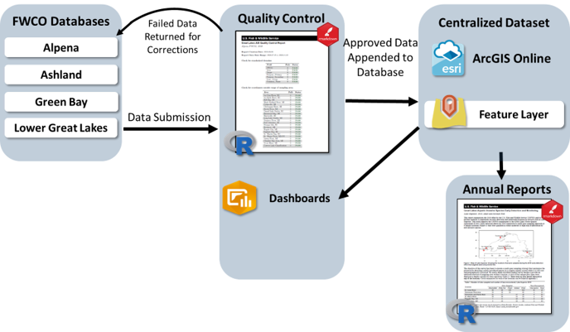
Great Lakes AIS Early Detection Monitoring
Data Team
Standardized workflows
Data management
Unified annual report
Notes:
JC

Slide 26
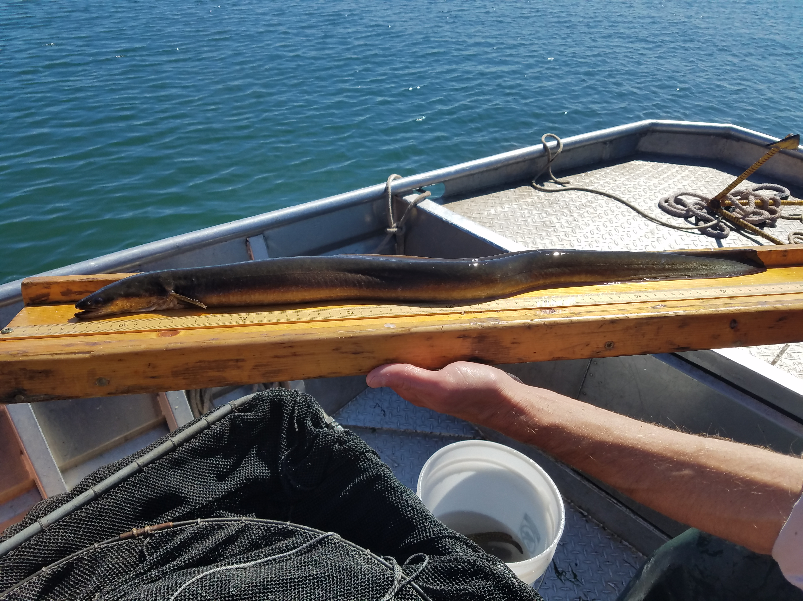


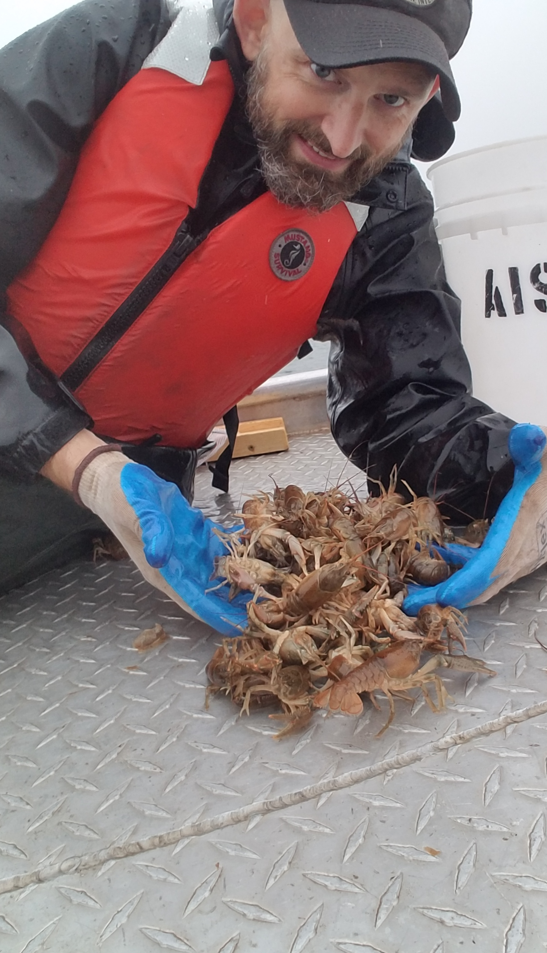
Microsoft Word Demonstration
Notes:
JW

Slide 27



PDF Demonstration
Notes:
JC

Slide 28


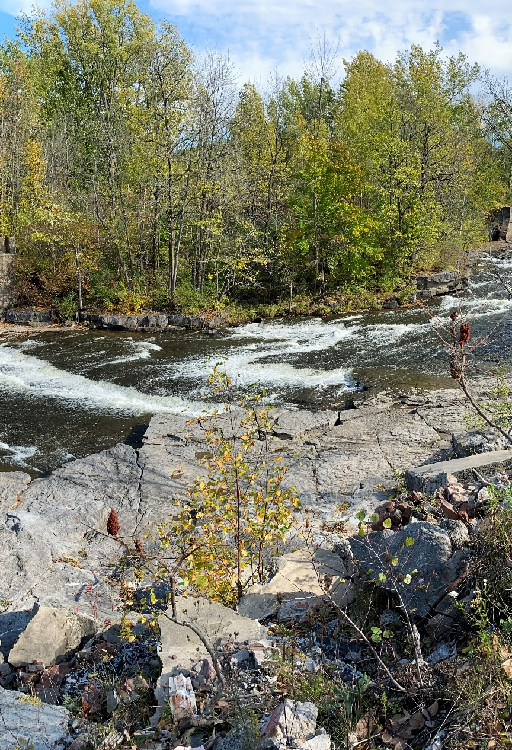
HTML Demonstration
Notes:
JW

Slide 29


Western Snowy Plover Exercise!

Slide 30

Q & A Session!
Notes:
Everyone

Slide 31
Shiny apps and dashboards
Shiny app
https://shiny.rstudio.com/
Flexdashboards
https://pkgs.rstudio.com/flexdashboard/
Shiny Dashboards
https://rstudio.github.io/shinydashboard/

Slide 32
Citation managers
Citation database
Allows you to store and manage research materials
Captures metadata from resources & allows you to generate and format bibliographies in citation styles you specify

Slide 33



Citation managers
 | Zotero | Mendeley | EndNote
Cost | Free and open source | Free | $250 for individual license (EndNote Basic free with limited capabilities)
Word processor compatibility | Word, Google Docs, LibreOffice, integration with R Markdown (R Studio v4.0) | Word, LibreOffice | Word, LibreOffice, Pages
Citation styles | Over 10,000 styles in .csl format | Over 10,000 styles in .csl format | 6,000 styles in .ens format

Slide 34
Having trouble downloading packages?
Are you connected to the network or VPN?
If so, try running this code in your console:
system2("setx", args = c("R_LIBCURL_SSL_REVOKE_BEST_EFFORT", "TRUE"))

Slide 35
Version Control
Git hub (https://github.com/)
Git lab (https://about.gitlab.com/)
Can either:
Initialize new git repository
Clone existing git repository
Check out GitHub tutorial here
Notes:
Popular version control platforms are Git hub https://github.com/ and Git lab https://about.gitlab.com/ To use these free platforms, create an account. Once you have an account, you can either initialize a new git repository or clone an existing one.
There’s a course-worth of material on git hub which we encourage you to check out but is beyond the scope of this course. McCrea Cobb put a great presentation together on using GitHub. We’ve provided the URL link here for you to check out on your own time.

Slide 36
Tables
Knitr (kable): limited capabilities but works in all outputs
Reactable: interactive, searchable/filterable tables. HTML only
kableExtra: lots of customization. HTML and PDF only
Flextable: lots of customization. HTML, PDF, and office (word or power point)
Many more…
Notes:
There are a variety of options available for creating tables in Rmarkdown. Your needs and the document type you are rendering will influence your decision.

